Slide 1
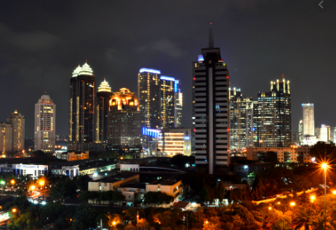
Feasibility Study of Opening New Korean Restaurant in Jakarta, Indonesia
Bangkit Dana Setiawan
Applied Data Science Capstone with IBM

Slide 2
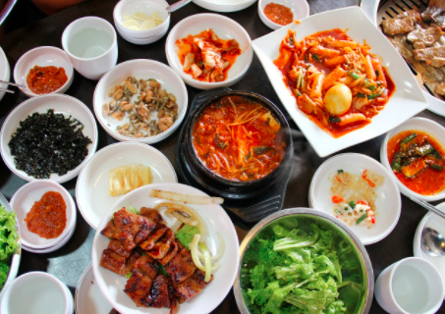

Introduction
High influence of Korean culture affects global business
Korean food industry is growing in in Indonesia
Jakarta as the capital city of Indonesia shows rapid economic growth in the last few years
Great time to open new Korean Restaurant

Slide 3
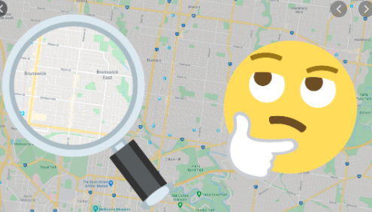
But Where????

Slide 4



OBJECTIVE
AUDIENCE
Objective
AUdience
The objective this capstone project is to analyze and select the best location in the Jakarta, as the capital city in Indonesia, to open a new Korean Restaurant.
This project is particularly useful to property developers and investors looking to open or invest in new Korean Restaurant in Jakarta, Indonesia.

Slide 5

DATA
Latitude and Longitude coordinates of those neighborhoods.
This will be required to plot the map and also get the venue data
After data from wikipedia already extracted, then latitude and longitude of the neighborhoods will be determined using the Python Geocoder package
List of neighborhoods in Jakarta.
This defines the scope of this project which only focus on the city of Jakarta, the capital city of Indonesia.
The neighborhoods data in Jakarta will be taken from Wikipedia page https://en.wikipedia.org/wiki/Category:South_Jakarta
This contains of 63 neighborhoods
This data will be utilized through web scrapping techniques to extract the data from Wikipedia page with the help of Python requests and beautifulsoup packages
Venue data through Foursquare API
This will be used for performing clustering in the Neighborhoods
Foursquare API will provide many categories of the venue data, we are particularly interested in the Korean Restaurant category in order to help us to solve the business problem.

Slide 6
METHODOLOGY
X
X
X
START
Web scrapping and extraction using list of neighborhood from Wikipedia by request and beautiful soup package
Get geographical latitude and longitude using Geocoder Package
All of data neighborhoods with latitude and longitude will be put in Pandas Dataframe
Dataframe will be visualized using folium map package
Foursquare ID and secret key need to be obtained by registering Foursquare Developer
100 Venues from 2000 m radius will be extracted using Foursquare API
Venue data in JSON format will be acquired from calling Foursquare API
Venues JSON format will be extracted based on venue name, category, and geographical
Each neighborhood will be grouped based on the mean of occurrence frequency of each category
Data will be filterd for only “Korean Restaurant”
Data will be performed clustering by using k-Means clustering into 3 cluster based on frequency occurences
Each cluster will be analyzed the frequency of occurrence for “Korean Restaurant”
X
X
X
END

Slide 7
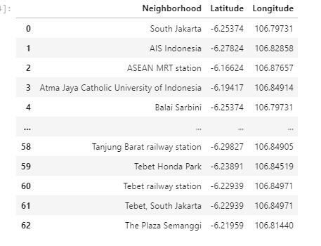
RESULT
Dataframe of Neighborhoods in Jakarta with Latitude and Longitude

Slide 8
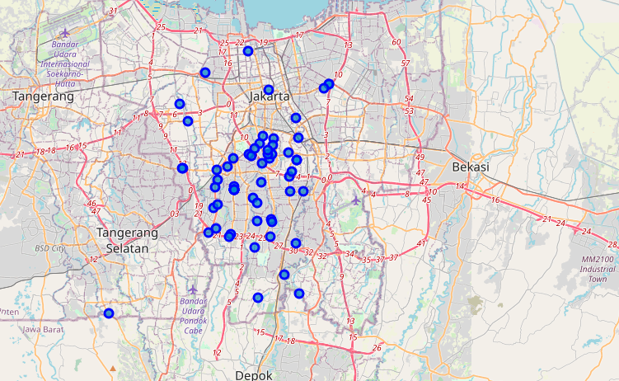
RESULT
Map Visualization of Neighborhoods in Jakarta

Slide 9
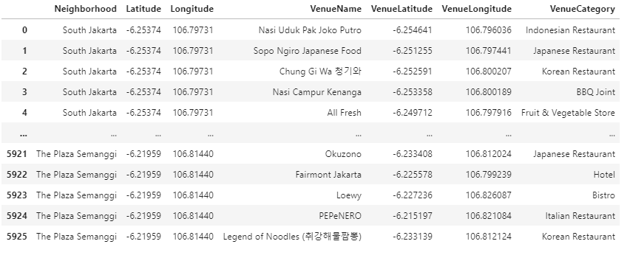
RESULT
100 Venues within radius 2000 meters in Neighborhoods
Based on the data, it is known that in the neighborhood in Jakarta have 234 unique venues categories.

Slide 10
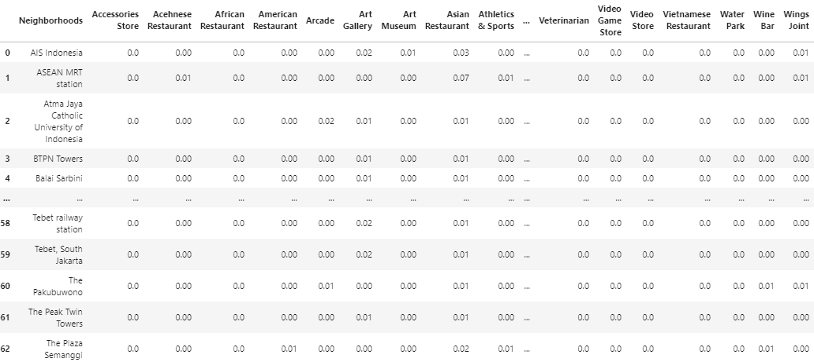
RESULT
Occurrence Frequency Venues Category For Each Neighborhod In Jakarta

Slide 11
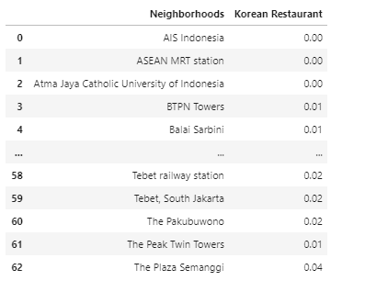
RESULT
Filtered Data for “Korean Restaurant” in Jakarta

Slide 12
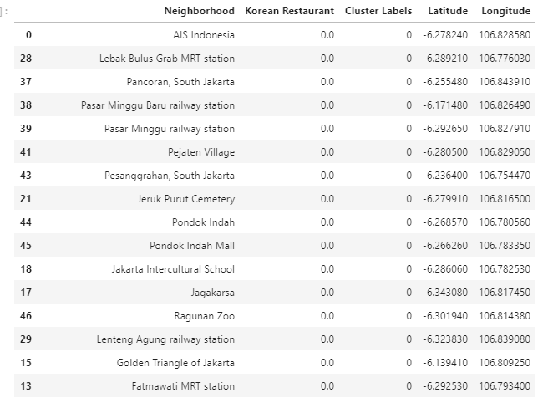
RESULT
Clustered Data for Korean Restaurant in Neighborhood in Jakarta: Cluster 0
Cluster 0:
Neighborhoods in Jakarta with low number of Korean Restaurant

Slide 13
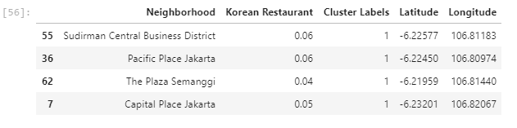
RESULT
Clustered Data for Korean Restaurant in Neighborhood in Jakarta: Cluster 1
Cluster 1:
Neighborhoods in Jakarta with high number of Korean Restaurant

Slide 14
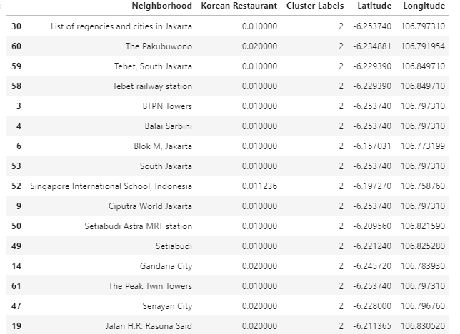
RESULT
Clustered Data for Korean Restaurant in Neighborhood in Jakarta: Cluster 2
Cluster 2:
Neighborhoods in Jakarta with moderate number of Korean Restaurant

Slide 15
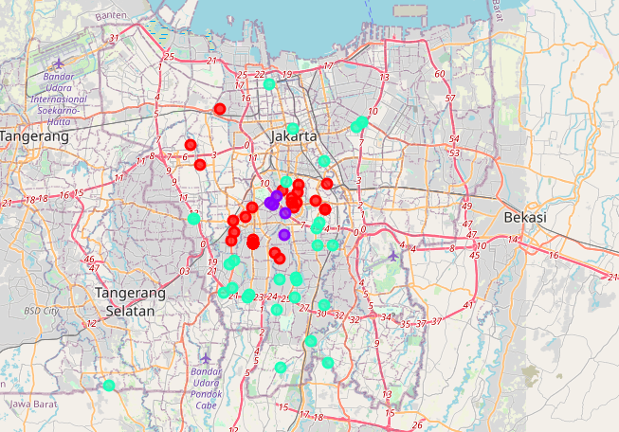
RESULT
Clustered Data for Korean Restaurant in Neighborhood in Jakarta: Visualization Map
Legends
Red Color: Cluster 0
Purple Color: Cluster 1
Mint Color: Cluster 2

Slide 16
DISCUSSION
Cluster 0
Cluster 2
Cluster 1
This project recommends property developers to capitalize on these findings to open new Korean restaurant in neighborhoods in cluster 0 with little to no competition.
Property developers with unique selling propositions to stand out from the competition can also open new Korean restaurant in neighborhoods in cluster 2 with moderate competition.
Lastly, property developers are advised to avoid neighborhoods in cluster 1 which already have high concentration of Korean restaurant and suffering from intense competition.
Increasing number of Korean Restaurant

Slide 17
CONCLUSION
This project recommends property developers to capitalize on these findings to open new Korean restaurant in neighborhoods in cluster 0 with little to no competition.
Property developers with unique selling propositions to stand out from the competition can also open new Korean restaurant in neighborhoods in cluster 2 with moderate competition.
Lastly, property developers are advised to avoid neighborhoods in cluster 1 which already have high concentration of Korean restaurant and suffering from intense competition.

Slide 18
Thank you
Bangkit Dana Setiawan
Applied Data Science Capstone with IBM

